Slide 1
SUCCESSIVE OVER RELAXATION

Slide 2
Iterative Methods
An iterative technique to solve Ax=b starts with an initial approximation X⁽⁰⁾ and generates a sequence i.e. x₍₁₎ , x₍₂₎, x₍₃₎, ….
a₁₁ a₁₂ a_{13 ……} a_{1n}
a₂₁ a₂₂ a_{23 ……} a_{2n}
a₃₁ a₃₂ a_{33 ……} a_{3n}
. . . .
. . . .
. . . .
a_{m1} a_{m2} a_{m3…} a_{mn}
x₁
x₂
X₃
.
.
.
x_{m}
b₁
b₂
b₃
.
.
.
b_{m}
=

Slide 3

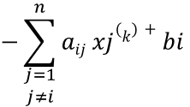
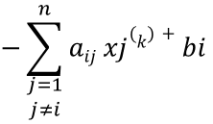

The Jacobi Iterative Method
This method is called the Jacobi iterative method which takes an initial Guess x_{i}⁽⁰⁾
Algorithm: Jacobi Iterative Method
Step 1: Takes the initial Guess x_{i}⁽⁰⁾ _{where i =1,2,3,4…, n}
Step 2: set k = 1
Step 3: while (k <= n) do step 4 – 6
step 4: for i = 1,….,n
step 5: if || X_{i}^{(k+1)} – X_{i}^{(k)} || < tol Then output (x₁,…, x_{n})
STOP
step 6: K = K + 1
Step 7: output (x₁,…, x_{n})
Step 8: EXIT
$$−\sum_{\begin{aligned}j=1 \\ j≠i\end{aligned}}^{n}{aij xj(k)+bi}$$
$xi$ =
$$aii$$
Note: n is number of iterative / loop
$$−\sum_{\begin{aligned}j=1 \\ j≠i\end{aligned}}^{n}{aij xj(k)+bi}$$
$xi$ =
$$aii$$
_{Note: tol is the tolerance}

Slide 4

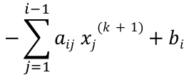
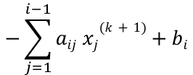
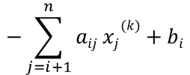
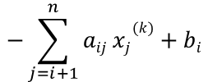
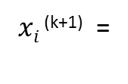

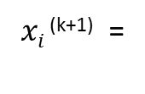
The Gauss Seidel Iterative Method
This method is called the Gauss Seidel iterative method which takes an initial Guess x_{i}⁽⁰⁾
and compute x_{i}^{(k)} using most recently calculated values.
Algorithm: Gauss Seidel Iterative Method
Step 1: Takes the initial Guess x_{i}⁽⁰⁾ _{where i =1,2,3,4…, n}
Step 2: set k = 1
Step 3: while (k <= n) do step 4 – 6
step 4: for i = 1,….,n
step 5: if || X_{i}^{(k+1)} – X_{i}^{(k)} || < tol Then output (x₁,…, x_{n})
STOP
step 6: K = K + 1
Step 7: output (x₁,…, x_{n})
Step 8: EXIT
$$−\sum_{j=1}^{i−1}{aij xj(k+1)+bi}$$
$$−\sum_{j=i+1}^{n}{aij xj(k)+bi}$$
$xi$ ^{(k+1)} =
$$aii$$
$$−\sum_{j=1}^{i−1}{aij xj(k+1)+bi}$$
$$−\sum_{j=i+1}^{n}{aij xj(k)+bi}$$
$xi$ ^{(k+1)} =
$$aii$$

Slide 5
The Successive Over-Relaxation Method (SOR)
The SOR is devised by applying extrapolation to the GS method. In the Equation the R is known as the Residual and note is equal to gauss seidel method
Therefore the equation can be written like this
And the $ω \text{is} \text{the} \text{extrapolation} \text{factor}\text{. }\text{The} \text{idea} \text{is} \text{to} \text{choose} \text{a} \text{value} \text{of} ω \text{that} \text{will} \text{accelerate} \text{the} \text{rate} \text{of} \text{convergence}\text{. }\text{and} \text{it} \text{converges} \text{faster} \text{than} \text{Gauss} \text{Seidel}$
Gauss Seidel
under-relaxation
over-relaxation

Slide 6
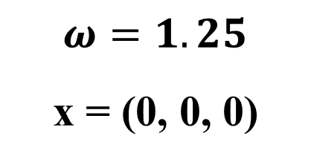
SOR: Example
$$ω=1.25$$
x = (0, 0, 0)

Slide 7
What is an ill conditioned system?
A system Ax=b is said to be ill conditioned if a little change in the coefficient matrix A or vector b, causes a relatively large change in the exact solution.
The concept is to check whether the solution is highly sensitive to changes in the values of matrix A or vector b

Slide 8
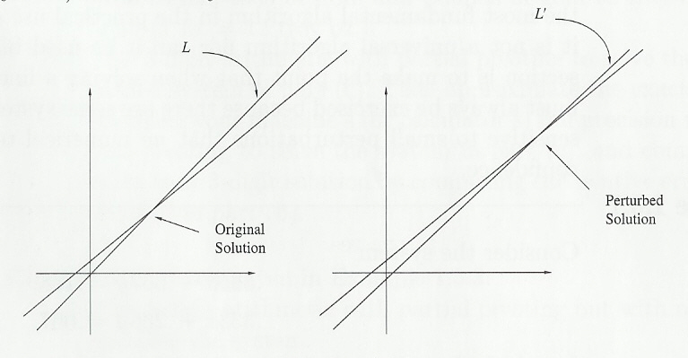
Could this be?
Ill-conditioned system:
….causes a great difference here!
A small change here……

Slide 9
Ill-Conditioned System:
Example II
Oh what a great difference
-402191
504330
-402858
504330

Slide 10
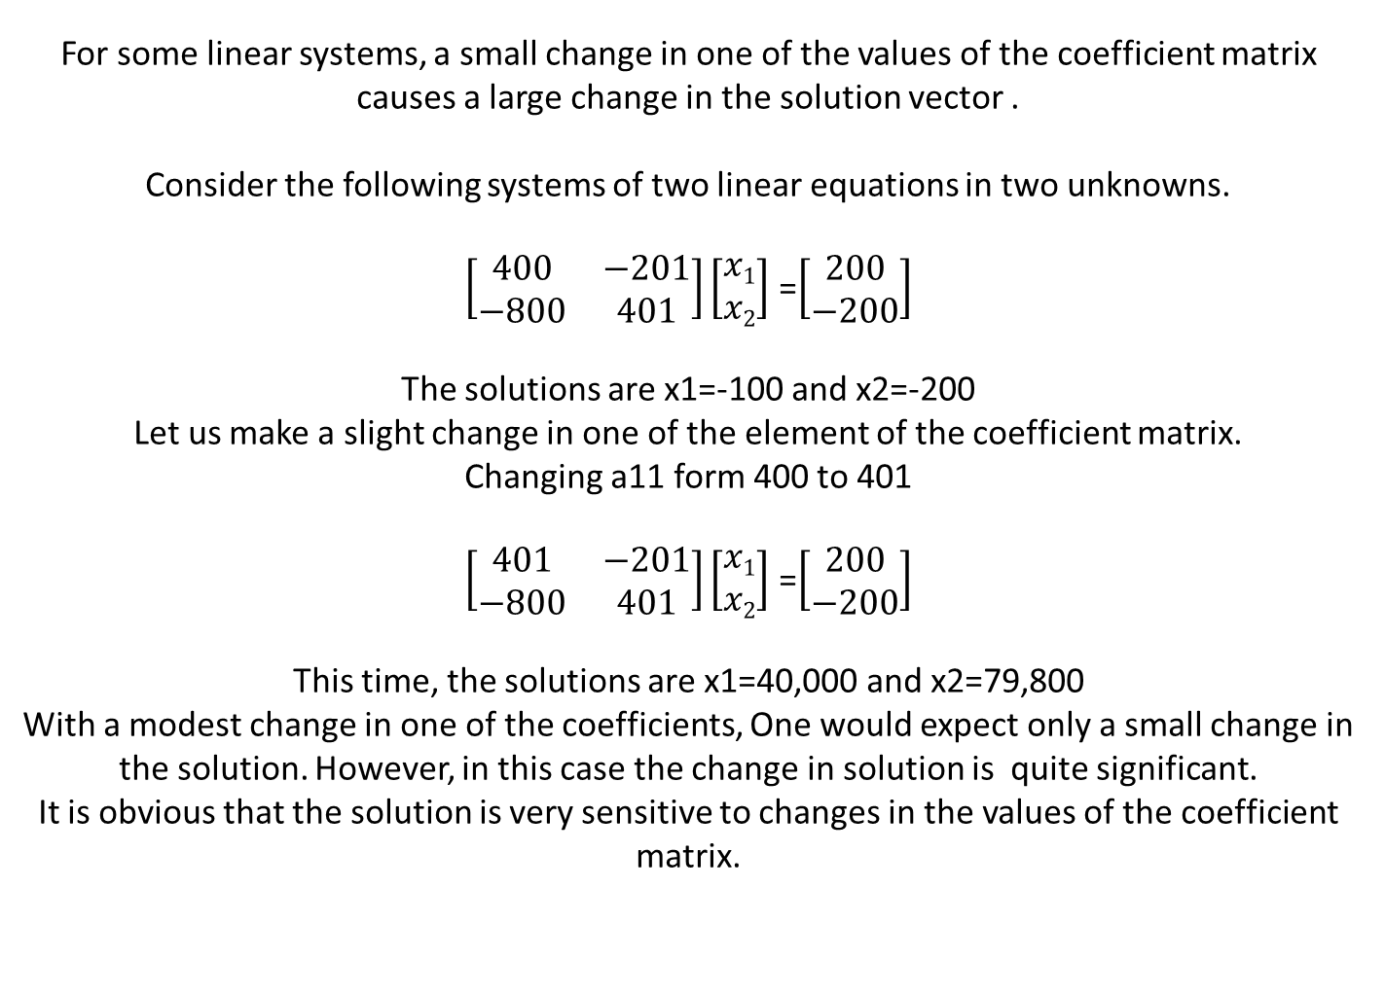
For some linear systems, a small change in one of the values of the coefficient matrix causes a large change in the solution vector .
Consider the following systems of two linear equations in two unknowns.
$\left[\begin{matrix}400 & −201 \\ −800 & 401\end{matrix}\right]\left[\begin{matrix}x1 \\ x2\end{matrix}\right]$ =$\left[\begin{matrix}200 \\ −200\end{matrix}\right]$
The solutions are x1=-100 and x2=-200
Let us make a slight change in one of the element of the coefficient matrix.
Changing a11 form 400 to 401
$\left[\begin{matrix}401 & −201 \\ −800 & 401\end{matrix}\right]\left[\begin{matrix}x1 \\ x2\end{matrix}\right]$ =$\left[\begin{matrix}200 \\ −200\end{matrix}\right]$
This time, the solutions are x1=40,000 and x2=79,800
With a modest change in one of the coefficients, One would expect only a small change in the solution. However, in this case the change in solution is quite significant.
It is obvious that the solution is very sensitive to changes in the values of the coefficient matrix.

Slide 11
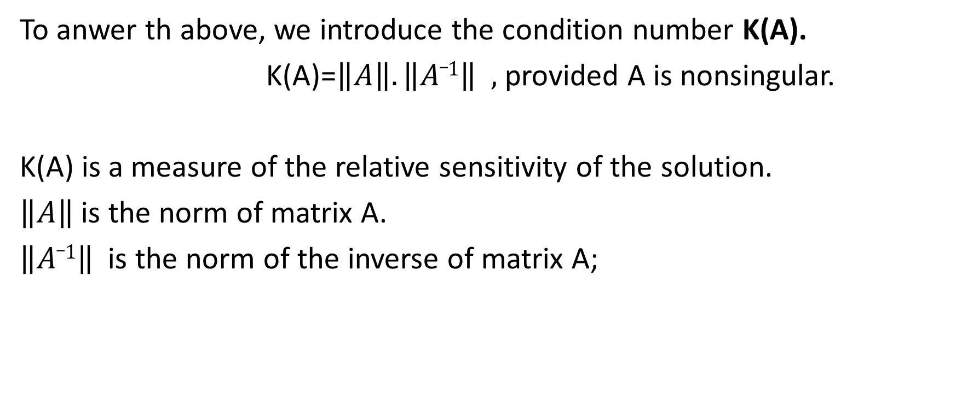
When is a system said to be ill conditioned?
To anwer th above, we introduce the condition number K(A).
K(A)=$\left\|A\right\|.\left\|A_1\right\| ,$ provided A is nonsingular.
K(A) is a measure of the relative sensitivity of the solution.
$\left\|A\right\|$ is the norm of matrix A.
$\left\|A_1\right\|$ is the norm of the inverse of matrix A;

Slide 12
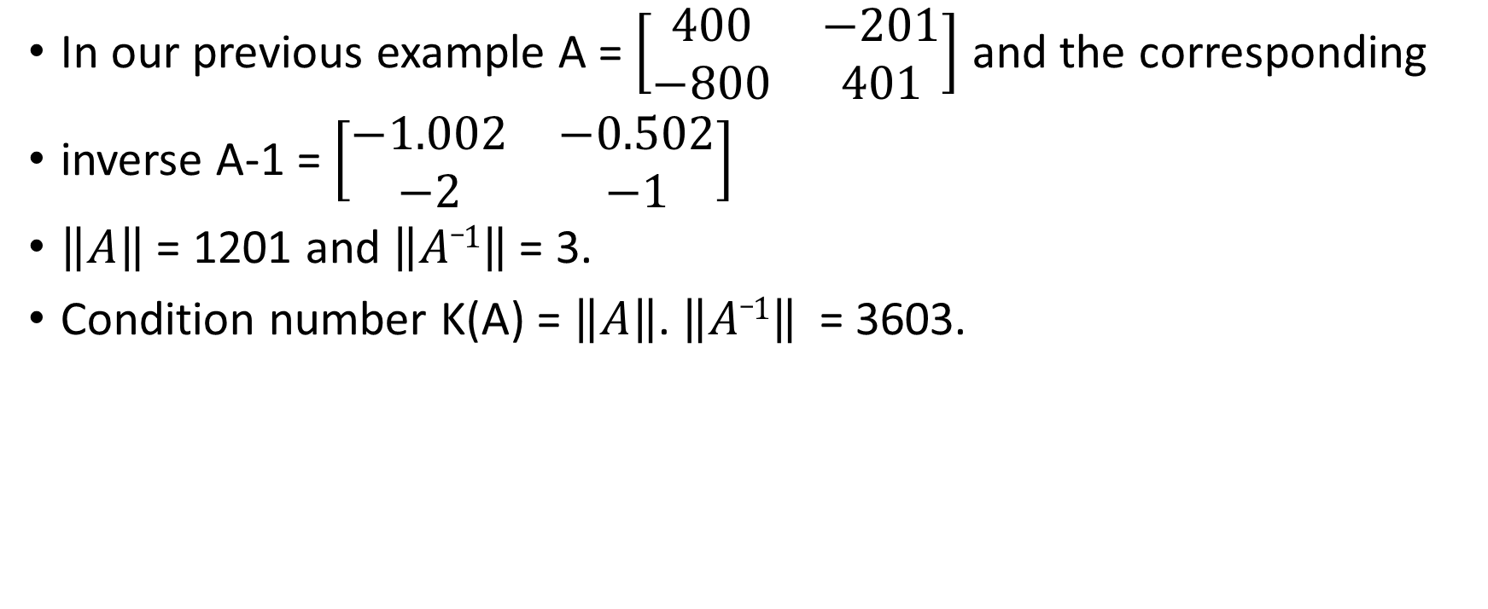
In our previous example A = $\left[\begin{matrix}400 & −201 \\ −800 & 401\end{matrix}\right]$ and the corresponding
inverse A-1 = $\left[\begin{matrix}−1.002 & −0.502 \\ −2 & −1\end{matrix}\right]$
$\left\|A\right\|$ = 1201 and $\left\|A_1\right\|$= 3.
Condition number K(A) = $\left\|A\right\|$. $\left\|A_1\right\|$ = 3603.

Slide 13
Conclusion
If the Condition number K(A) is large, the system is regarded as being ill-conditioned. But how large does K(A) have to be before a system is regarded as ill-conditioned? There is no clear threshold .

